Slide 1

Australian Economic Market Outlook and implications for investors
Shane Oliver
Head of Investment Strategy and Chief Economist

Slide 2
Outlook for 2012
Budget cutbacks in Europe and US, but global monetary easing, including in Aust
Global growth to slow to 3% - ranging from mild recession in Europe to 8% growth in China
Expect 3% growth in Australia, but a slight rise in unemployment
Europe woes will result in a volatile ride, but expect stronger share markets helped by attractive valuations, excessive pessimism and monetary easing
Bonds are poor value
The $A is likely to remain volatile but strong

Slide 3
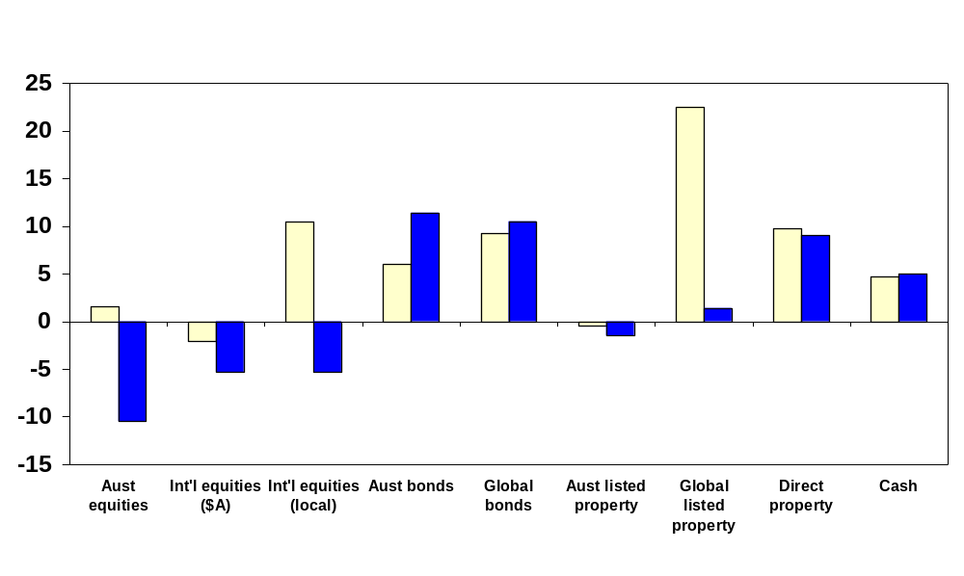
2011 saw disappointing returns with global growth worries impacting share markets

Slide 4
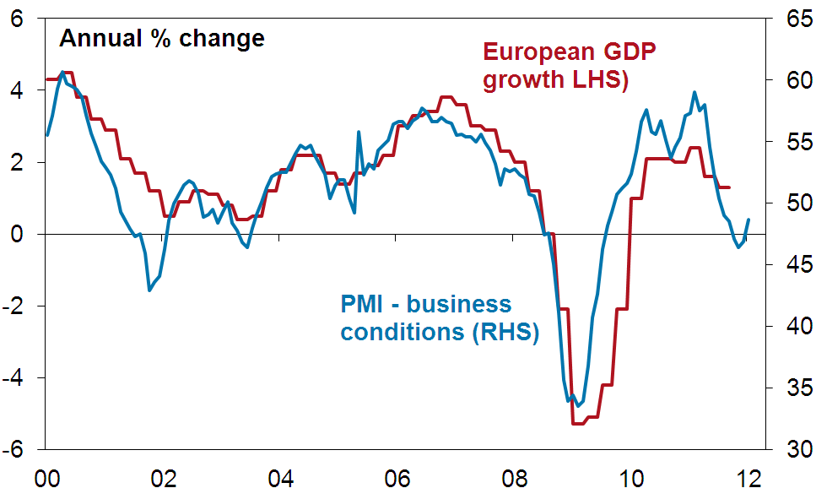
Europe is probably already in recession, but recent economic indicators have improved…

Slide 5
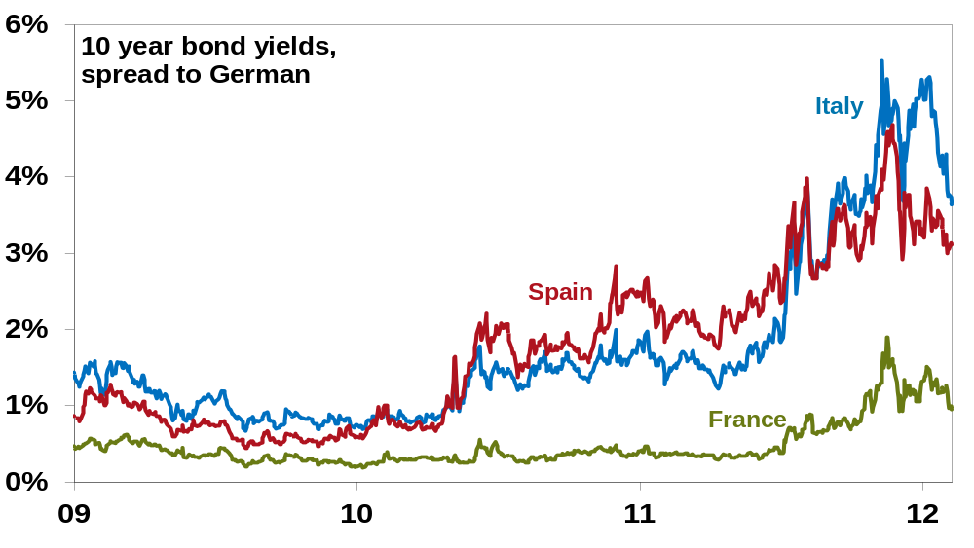
…and ECB support for banks and bond buying suggest the risk of a meltdown has faded

Slide 6

Global business conditions indicators generally have stabilised or improved – suggesting less risk of global recession
70
100
US ISM (LHS)
60
90
50
80
European PMI
40
Japan PMI
70
(LHS)
(LHS)
India PMI (RHS)
30
60
20
50
China PMI (RHS)
10
40
Brazil PMI (RHS)
0
30
00
01
02
03
04
05
06
07
08
09
10
11
12
Source: Bloomberg, AMP Capital Investors
Notes:
6

Slide 7
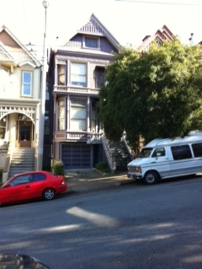
Love and Haight
Source: AMP Capital Investors

Slide 8
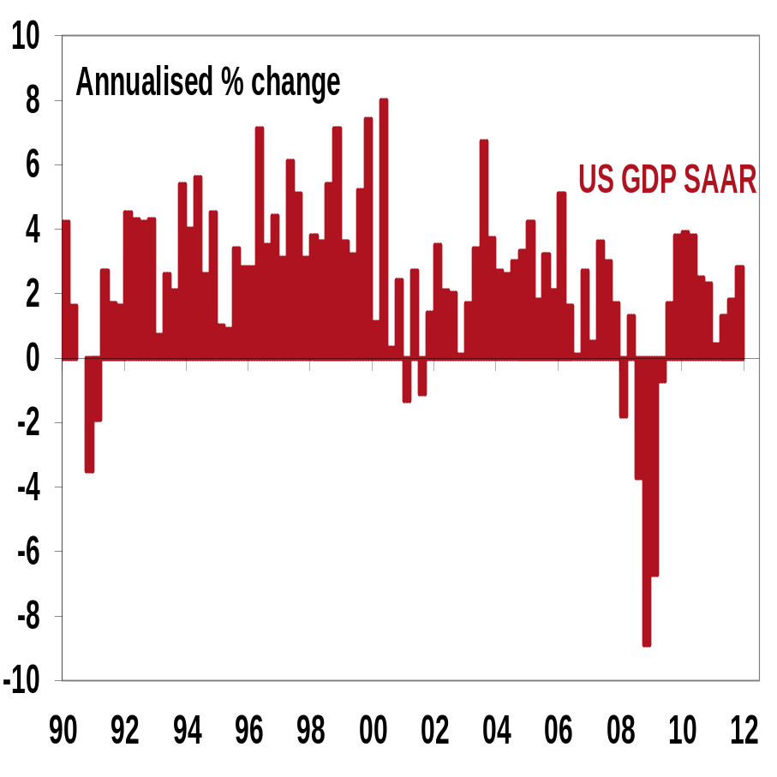
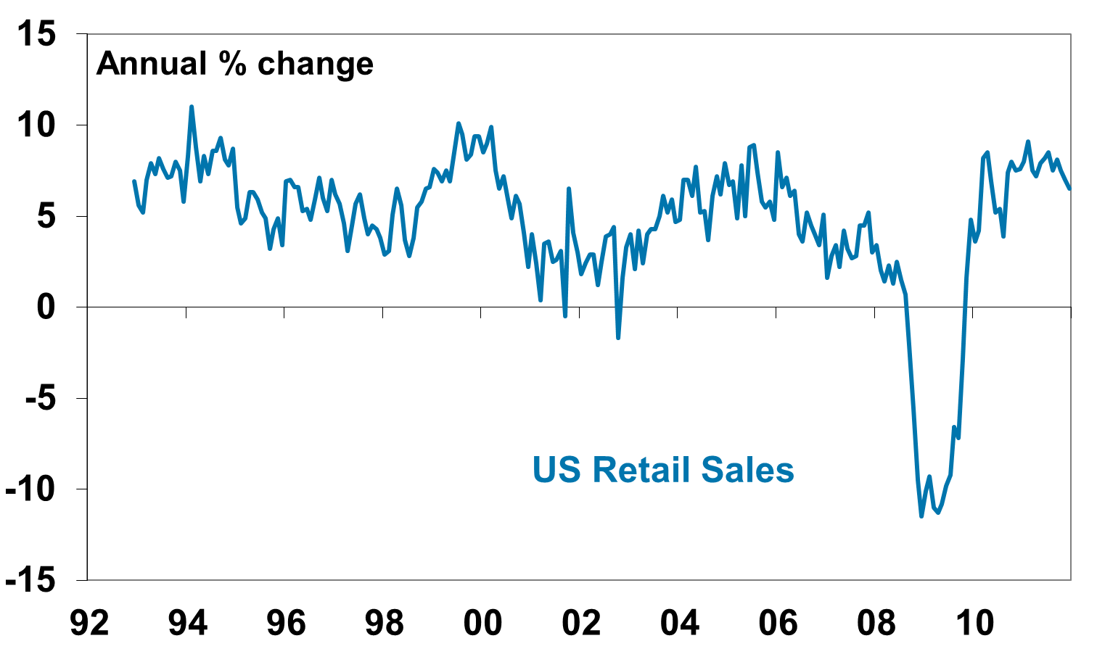
The US has avoided the much feared “double dip recession”
GDP Growth
Retail Sales
Source: Datastream, AMP Capital Investors
Notes:
8
\\capricorn\ecmkst\Trinh\Signposts v1.xls
C~ US Retail
\\capricorn\ecmkst\Trinh\US Turning Points .xls
Chart (H starts)

Slide 9
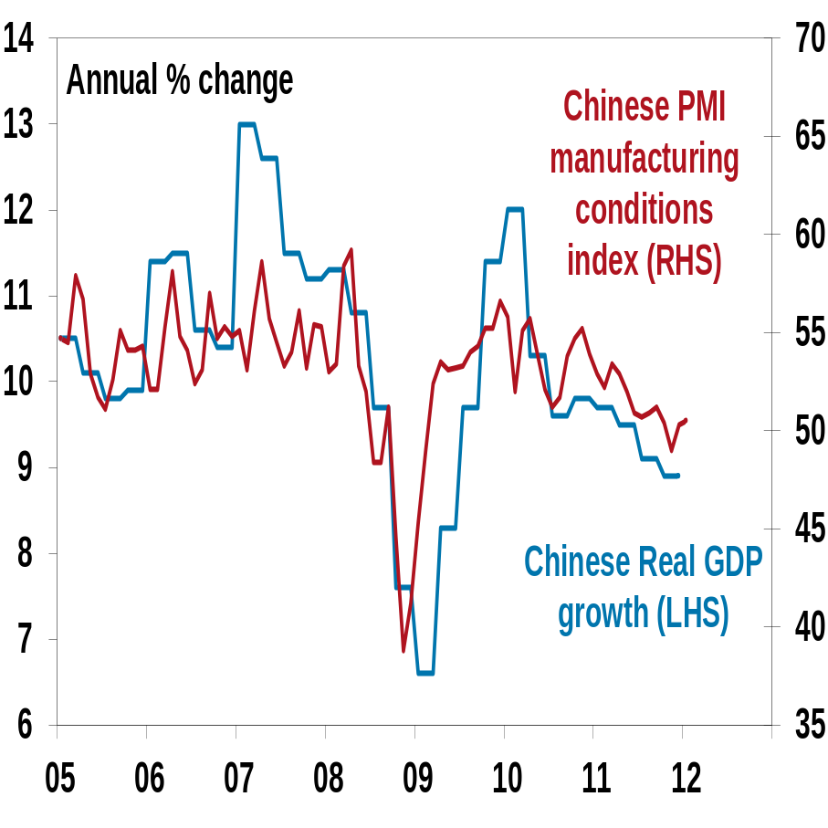
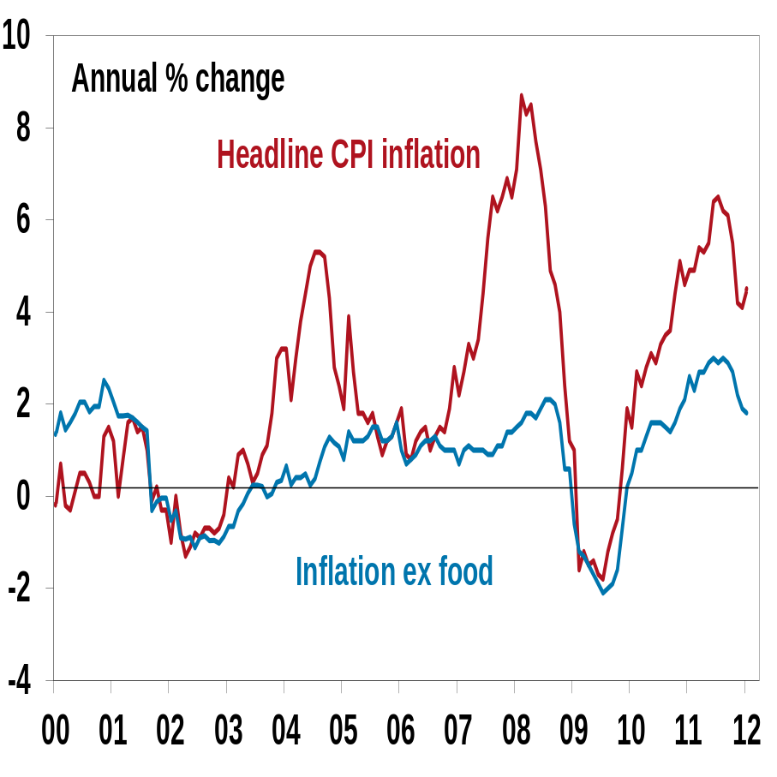
There is no sign of a hard landing in China and authorities are starting to ease up on the policy brake
Growth Slowing
Cooling Inflation = room to ease
Source: Datastream, AMP Capital Investors
9
Notes:
9
9
F:/BOB/CHINA ECON DATA.XLS
CHART: 2
MARCH 2010

Slide 10
Emerging countries are the dominant driver of global growth
Contribution to global growth
100%
3 year moving average
90%
80%
Others -
mainly
70%
emerging
60%
countries
50%
40%
30%
China
20%
Japan
10%
Europe
0%
The US
2000
2001
2002
2003
2004
2005
2006
2007
2008
2009
2010
2011
Source: IMF, AMP Capital Investors

Slide 11
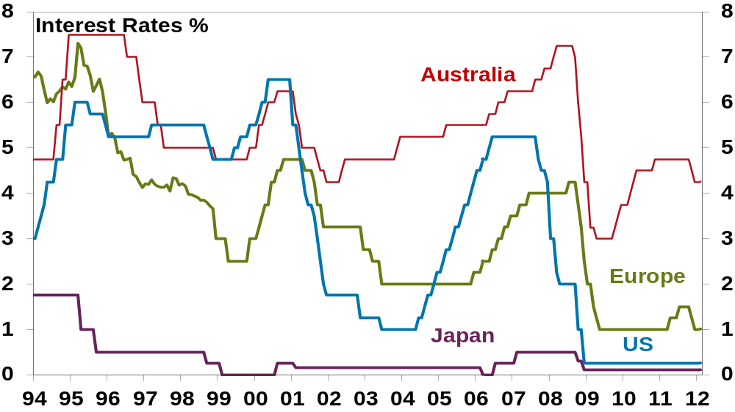
Interest rates are likely to remain low globally. Australian and European interest rates to fall further
Source: Datastream, AMP Capital Investors
Notes:
11
FILE NAME: F:/TRINH/SIGNPOSTS v1.xls
CHART: C-INTERESTRATES(2)
LAST UPDATED: April 2011

Slide 12
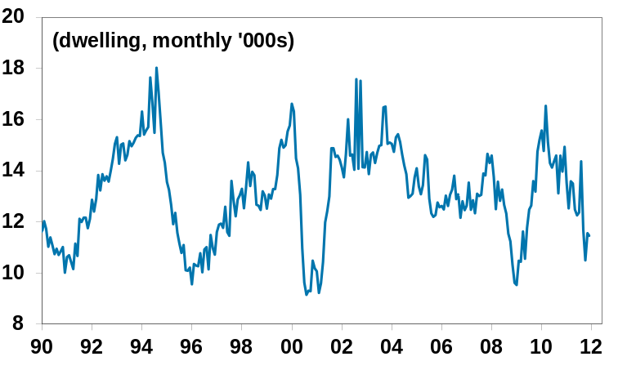
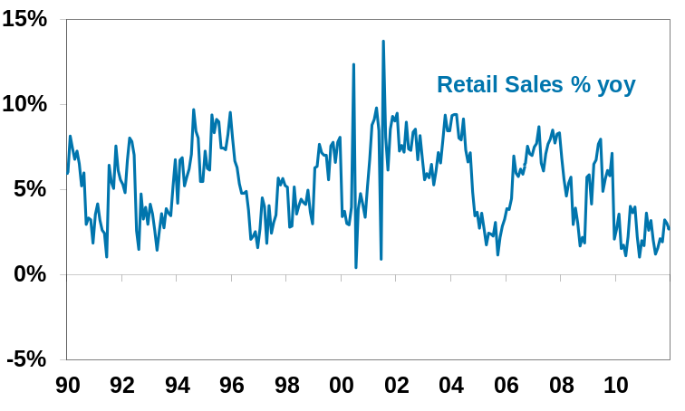
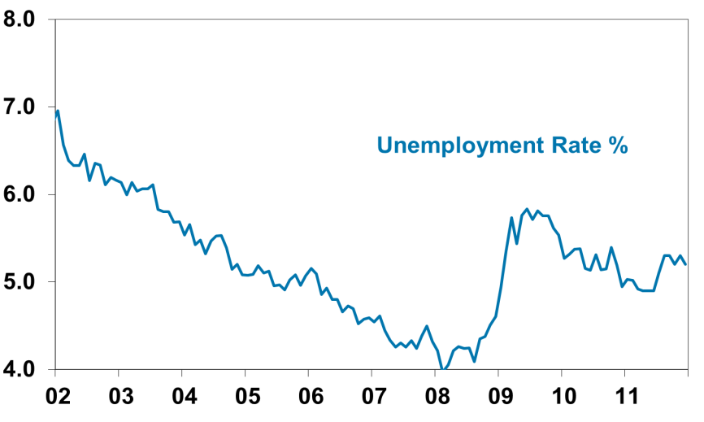
The Aust economy is recording moderate growth – but is two speed. Expect more RBA rate cuts
The mining boom is driving an investment boom
But building approvals are soft
40%
Business Investment, Fin year, % change
30%
Estimate
20%
10%
0%
-10%
-20%
90
92
94
96
98
00
02
04
06
08
10
12
retail sales are weak
and the labour market is soft
Source: Thomson Financial, AMP Capital Investors
12
Notes:
12
12
Building Approvals
F/Trinh/aus_building.xls > Charts – Bldg (Col N Row 120)
Retail Sales
F/Trinh/aus_retail.xls > Chart (Col P Row 18)
Labour Market
F/Trinh/AUST_RBA_DATA.xls > Charts (Col As Row 177)
Business Investment
F/Trinh/aus_CAPEX.xls > Chart-CAPEX (2)

Slide 13
Australia is not immune, but is reasonably well placed
Interest rates have a long way to go to zero if need be
Low public debt by global standards means scope for more fiscal stimulus if needed
The $A will act as a buffer if need be
Corporates have low gearing and are cashed up
Australian households have built up a large savings buffer
The mining investment boom provides a degree of resilience
Our key export markets in Asia are in reasonably good shape
Source: AMP Capital Investors

Slide 14
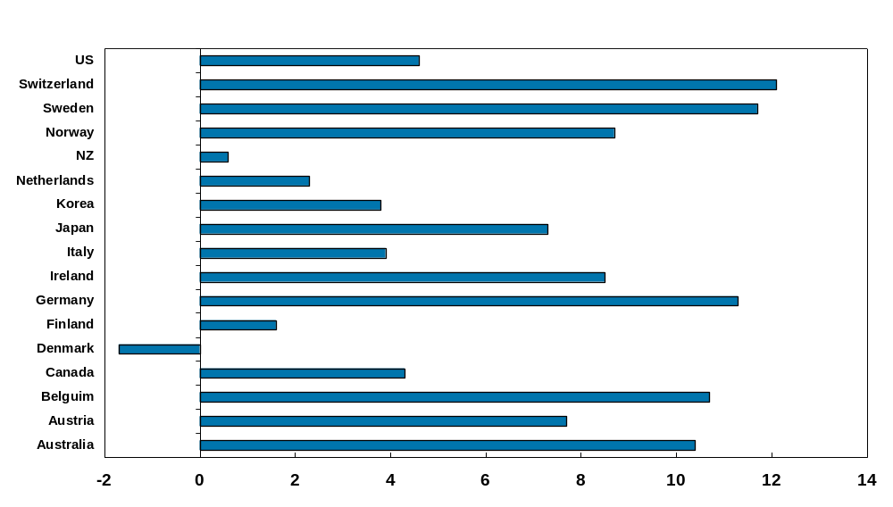
Australian household saving rate is near top of the OECD
Source: OECD, AMP Capital Investors

Slide 15
Global growth watch list for 2012
Italian bond yields
US ISM manufacturing conditions index
Chinese money supply growth
$A
….December 21, when Mayan calendar ends!

Slide 16
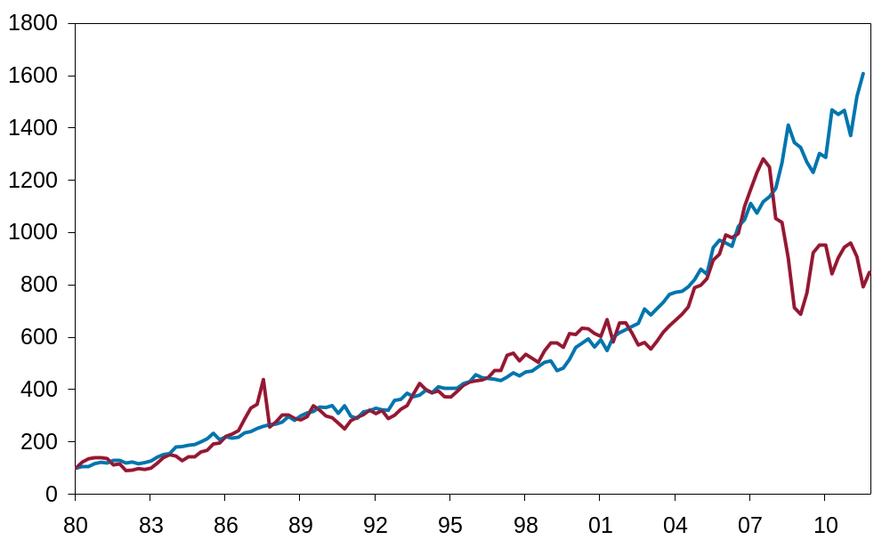
Australian shares are way below the level suggested by profits
Source: Thomson Financial, AMP Capital Investors
16
Notes:
16
16
Last Updated: 07 MAY 09
Excel File Name: F:/Nader/Earnings/AustEqvProfits.xls
Chart: Chart 1
AUGUST 2010

Slide 17
Australian shares are providing a higher cash flow than bonds and bank deposits
10
Percent
9
Grossed up dividend
yield
8
7
6
5
4
Bank 1 year term
deposit rate
3
00
01
02
03
04
05
06
07
08
09
10
11
12
Source: RBA, Bloomberg, AMP Capital Investors

Slide 18
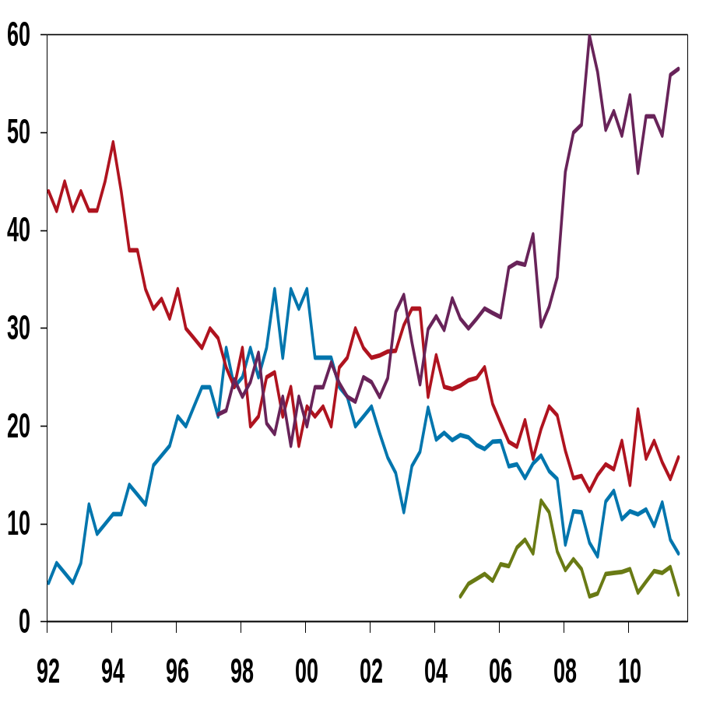
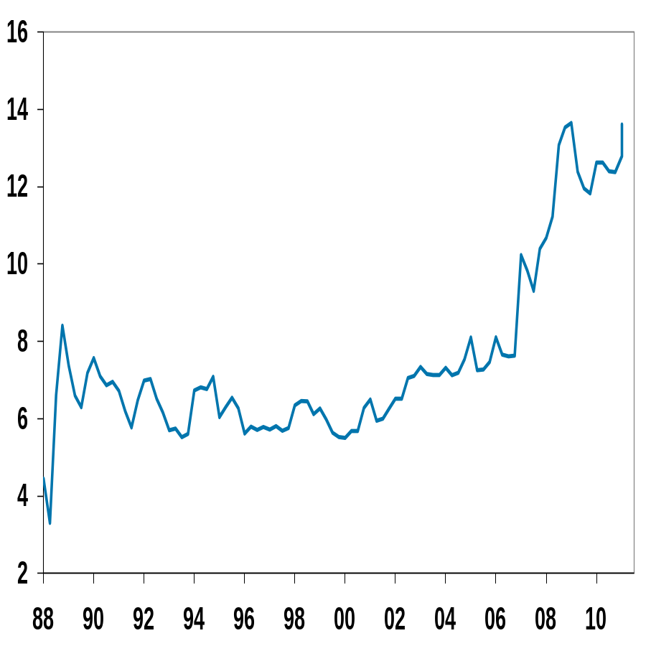
There is plenty of scepticism regarding shares and plenty of cash still on the sidelines
Wisest place for savings
Superannuation Funds cash weightings

Slide 19

The power of compound interest
Bought for 10 cents in 1938 and sold for $1m in 2010!
Souce: AMP Capital Investors

Slide 20
Shares beat cash & bonds over long term - Australia
$1,000,000
Value of $1 invested
in Jan 1900
$287,087 (11.9%pa)
$100,000
$10,000
Australian shares
$1,000
$636 (5.9% pa)
$100
Aust bonds
$150
$10
(4.6%pa)
Aust cash
$1
1900
1910
1920
1930
1940
1950
1960
1970
1980
1990
2000
2010

Slide 21
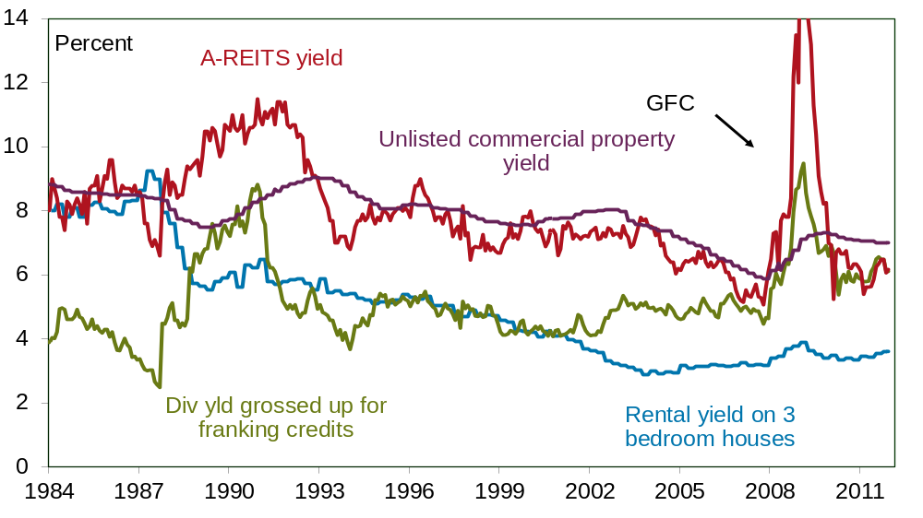
Commercial property is more attractive than housing given much higher rental yields
Source: Thomson Reuters, REIA, AMP Capital Investors
21
Notes:
21
21
F:/nader/charts/direct_property.xls
Chart = AUS Residential v Div Yield (3)

Slide 22
Very low bond yields will mean low returns over the next 5-10 years
US 10 year bond yields at their
lowest level ever
Australian 10 year bond yields
at their lowest since 1951
16
20
10 year bond yield,
10 year bond yield,
18
14
percent
percent
12
16
14
10
12
8
10
6
8
6
4
4
2
2
0
0
1860
1880
1900
1920
1940
1960
1980
2000
1901
1921
1941
1961
1981
2001
Source: AMP Capital Investors

Slide 23
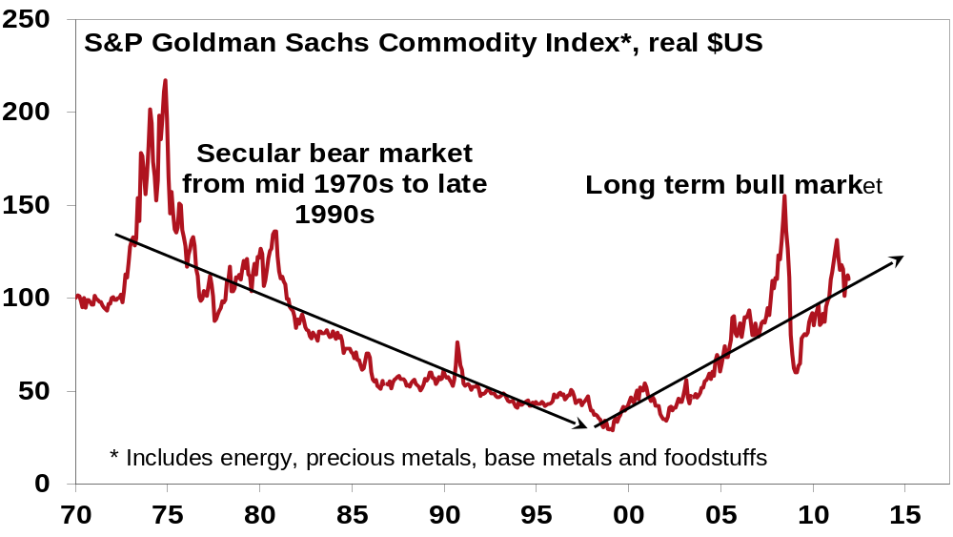
Commodity prices still in a long term uptrend
Source: Thomson Financial, AMP Capital Investors
23
Notes:
23
23
F:/BRENDAN/CHARTS/GSCI-CPIAdjust.xlx
CHART: 1
AUGUST 2010

Slide 24
Huge catch-up potential in China, along with other emerging countries, will drive commodity demand
 | Chinese level per person as % of US level per person
Road network | 14
Rail network | 6
Telephone lines | 43
Living space | 35
Passenger cars | 5
Source: AMP Capital Investors

Slide 25
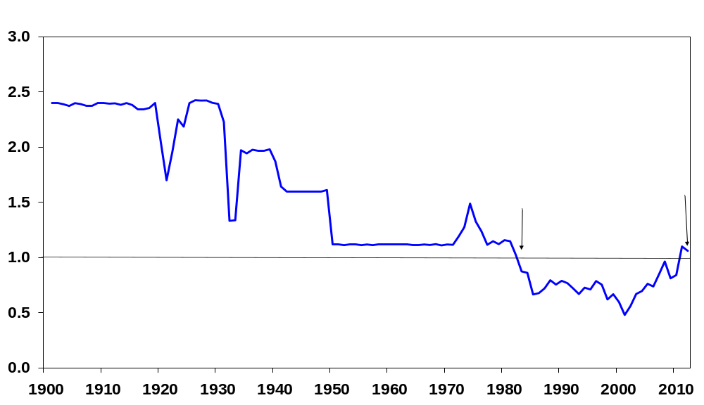
Expect the $A to remain relatively strong
Source: RBA, Thomson Financial, AMP Capital Investors

Slide 26
Medium term returns in traditional assets are likely to remain constrained and volatile
Private sector deleveraging in advanced countries
Fiscal austerity in Europe, the US and Japan
Extreme monetary policy settings
Easy gains from shift to low inflation are long over
Social unrest is on the rise
Policy pendulum swinging back to the left
Great reliance on emerging countries which are normally more volatile

Slide 27
Projected medium term returns, %pa, pre fees and taxes
 | Current Yield # | + Growth | = Return
US Equities | 2.0 | 4.5 | 6.5
UK Equities | 3.6 | 3.5 | 7.1
European Equities | 4.0 | 3.5 | 7.5
Japanese Equities | 2.5 | 2.5 | 5.0
Asia ex Japan Equities | 2.3 | 8.0 | 10.3
Emerging Equities | 2.6 | 7.0 | 9.6
World Equities, local currencies | 2.6 | 4.3 | 6.9
Australian Equities | 4.7 (6.1*) | 5.2 | 9.9 (11.3*)
Unlisted Commercial Property | 7.0 | 2.5 | 9.5
Australian REITS | 6.1 | 2.5 | 8.6
Global REITS | 5.5^ | 3.3 | 8.8
Unlisted Infrastructure | 6.0 | 4.0 | 10.0
Global Listed Infrastructure | 3.0 | 5.0 | 8.0
Australian Gov’t Bonds | 3.5 | 0.0 | 3.5
Australian Corporate Debt | 6.0 | 0.0 | 6.0
Australian Cash | 5.0 | 0.0 | 5.0
Diversified Growth Mix |  |  | 8.0
# Current dividend yield for shares, distribution/net rental yields for property and
5 year bond yield for bonds. ^ Assumes forward points averaging 2% point pa.
* With franking credits added in.
Source: AMP Capital Investors
27

Slide 28
Outlook for 2012
Budget cutbacks in Europe & US, but global monetary easing, including in Aust
Global growth to slow to 3% - ranging from mild recession in Europe to 8% growth in China
Expect 3% growth in Australia, but a slight rise in unemployment
Europe woes will result in a volatile ride, but expect stronger share markets helped by attractive valuations, excessive pessimism and monetary easing
Bonds are poor value
The $A is likely to remain volatile but strong
Source: AMP Capital Investors
Notes:
28
28
UPDATED: AUGUST 2010

Slide 29
What should investors consider in the current environment?
There is still a cycle – times of gloom eventually give way to times of boom global monetary easing, including rate cuts in Australia
The power of compound interest – regular investing of small amounts can compound to a big amount over long periods
Buy low and sell high - recent weakness provides opportunities for far sighted investors
Focus on investments providing decent and sustainable cash flows – such as dividends or rents
Invest for the long term – but for those with a short term horizon consider investment strategies with targeted outcomes in terms of return or cash flows
Avoid the crowd
Source: AMP Capital Investors
Notes:
29
29
UPDATED: AUGUST 2010

Slide 30
Important note
Neither AMP Capital Investors Limited (ABN 59 001 777 591) (AFSL 232497), nor any other company in the AMP Group guarantees the repayment of capital or the performance of any product or any particular rate of return referred to in this presentation.
Past performance is not a reliable indicator of future performance.
While every care has been taken in the preparation of this document, AMP Capital Investors makes no representation or warranty as to the accuracy or completeness of any statement in it including, without limitation, any forecasts.
This document has been prepared for the purpose of providing general information, without taking account of any particular investor’s objectives, financial situation or needs. An investor should, before making any investment decisions, consider the appropriateness of the information in this document, and seek professional advice, having regard to the investor’s objectives, financial situation and needs.
This document is solely for the use of the party to whom it is provided.

