Slide 1

Under the bonnet of ETF structures & price mechanisms
Robin Bowerman
Vanguard

Slide 2
Agenda
The good, the bad and the ugly about ETFs
  The media swirl
  Global and domestic trends
Under the bonnet - how ETFs work
  The role of the market maker
  ETF costs & spreads
  Managed Index Funds vs. ETFs
ETF Applications
Myths & misconceptions
2

Slide 3

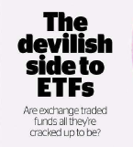


The bad news…
ASIC warns investors on ETFs
Stuart Washington
August 16, 2011 - 12:00AM
ASIC's move helps investors better understand the risk of delving into the market
Adele Ferguson
August 16, 2011
3

Slide 4
What is an ETF?
An ETF is an Exchange Traded Fund.
It is generally a diversified portfolio of securities constructed using an index approach that can be readily traded on a securities exchange like the ASX.
Investors need to understand the benefits of indexing to understand how ETFs can be powerful tools in portfolio construction
4

Slide 5
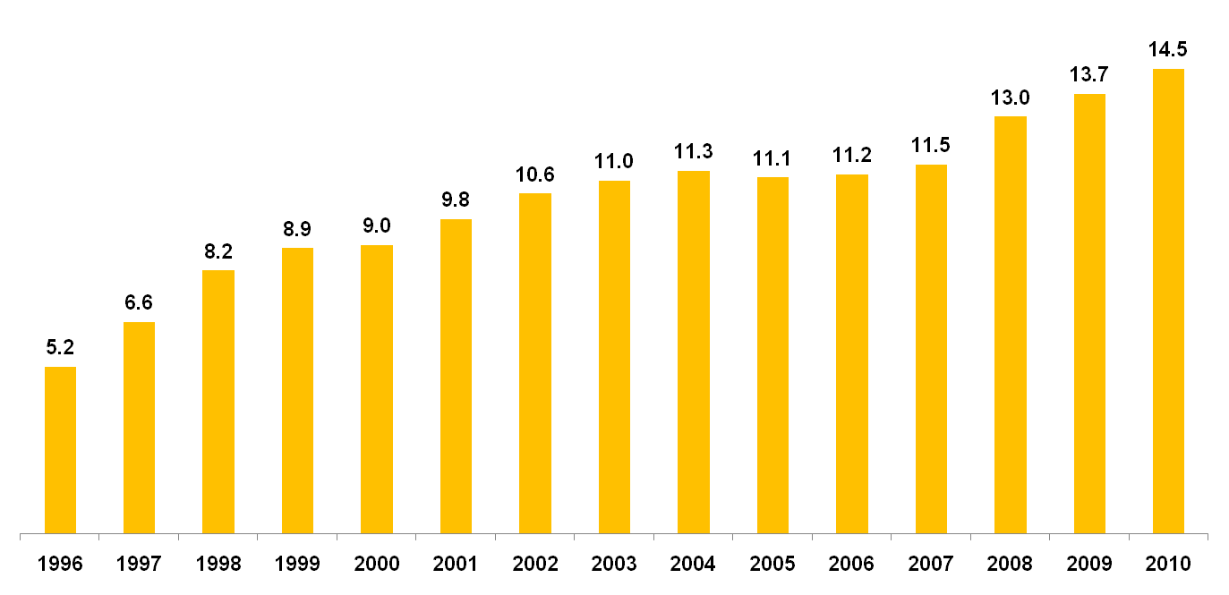
US index funds: a 15-year growth story
Equity Index Funds’ Share Continued to Rise
Percentage of equity mutual fund total net assets, 1996 - 2010
290 stock and bond index funds + 950 ETFs with $US 2.2 trillion
Source: ICI, 2011 Investment Company Fact Book
5

Slide 6
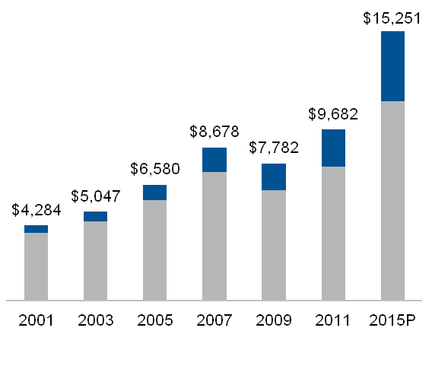
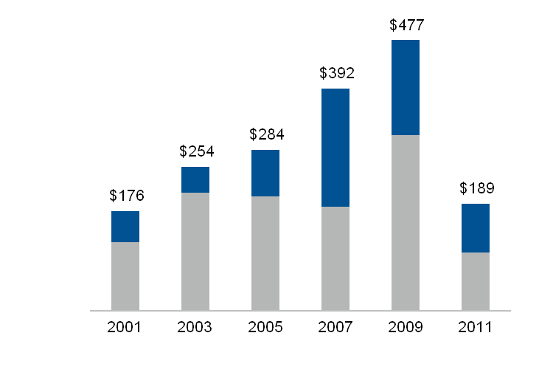
Index versus active assets and cash flows
Long-term mutual fund assets (billions)
Long-term mutual fund cash flows (billions)
Index LT | 10% | 11% | 13% | 16% | 20% | 22% | 26%
Active LT | 90% | 89% | 87% | 84% | 80% | 78% | 74%
Index LT | 31% | 18% | 29% | 53% | 35% | 45%
Active LT | 69% | 82% | 71% | 47% | 65% | 55%
Source: Strategic Insight, Vanguard. Data as of June 30, 2011.
6

Slide 7
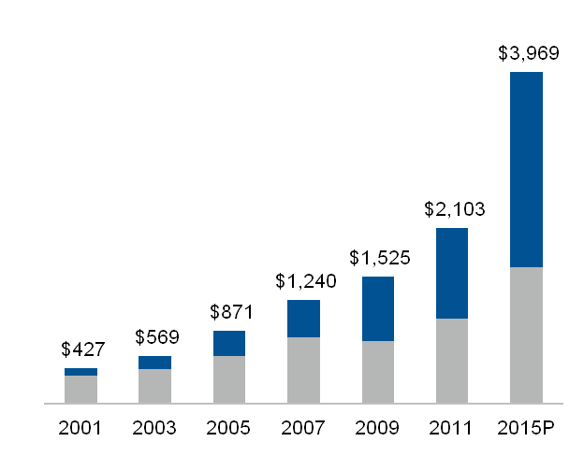
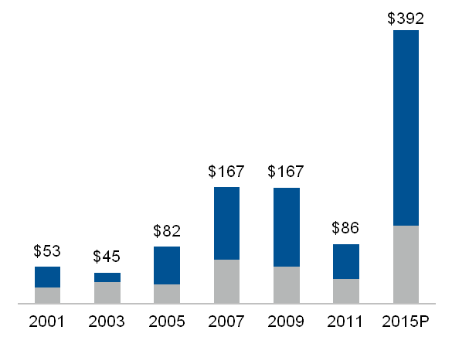
ETF assets and cash flow as a percentage of index funds
Long-term index fund assets (billions)
Long-term index fund cash flows (billions)
ETF | 19% | 26% | 35% | 36% | 51% | 51% | 59%
Index MF | 81% | 74% | 65% | 64% | 49% | 49% | 41%
ETF | 55% | 31% | 65% | 62% | 68% | 58% | 71%
Index MF | 45% | 69% | 35% | 38% | 32% | 42% | 29%
Asset and cash flow projections calculated by Vanguard using a FRC estimation of 18.5% Compound Annual Growth Rate (CAGR) for ETF AUM projections and 20.3% CAGR for ETF cash flow projections.
Source: Strategic Insight, FRC, Vanguard. Data as of June 30, 2011.
7

Slide 8
Exchange-Traded Product (ETP) marketplace and trends:
The ETP marketplace—worldwide
U.S. listed 1,103 ETPs, $1,014B
Worldwide ex-U.S. 2,502 ETPs, $455B
Worldwide 3,605 ETPs, $1,469B
Assets (in billions)
Number of ETPs
Source: Bloomberg LP as of December 31, 2010
8

Slide 9
ETFs provide asset owners with multiple ways to express their views
Equity
Global
Capitalisation e.g large, mid, small…
Sectors
Broad markets
Emerging markets
Countries
Inverse/leveraged
Styles Active Dividend Fundamental Infrastructure Real estate Shariah Thematic Private equity Value Growth
Fixed Income
Government
Corporate
Credit
Inflation
High yield
Mortgage backed
Emerging markets
Cash
EONIA, SONIA
Fed Funds
Currency
Developed currencies
Emerging market currencies
Inverse/leveraged
Strategy e.g carry, momentum…
Commodities
Broad
Sub-indices e.g energy, livestock, precious metals, industrial metals, agriculture…
Individual commodities
Based on physically held assets e.g gold, silver, platinum, palladium…
Based on futures
Based on forwards
Inverse/leveraged
Alternatives
Hedge funds
Carbon
Volatility
2670 ETFs with 6,021 ETF listings
1,149 ETPs¹ with 1,872 listings
Total: 3,819 products with 7,893 listings
Source: Blackrock, "ETF Landscape: Industry Highlights" as at April 2011

Slide 10
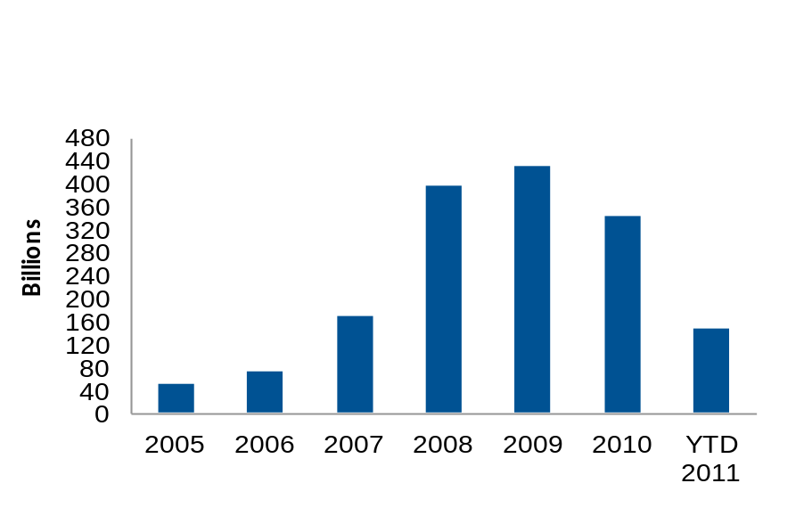
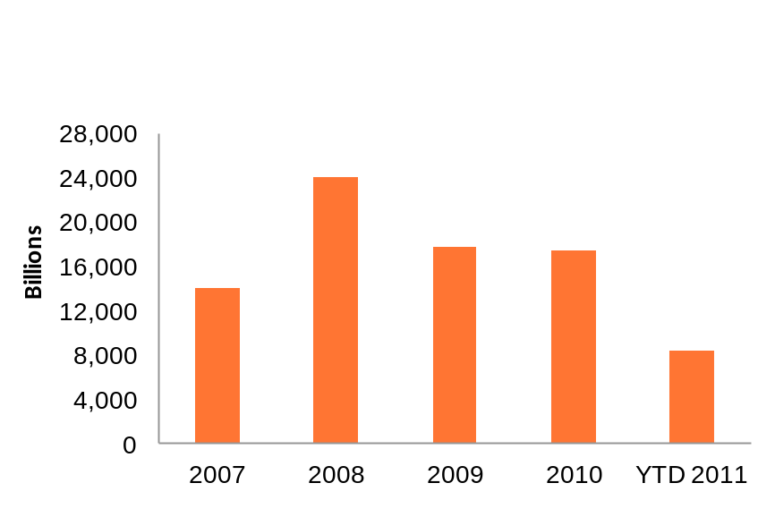
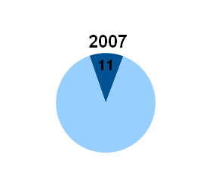
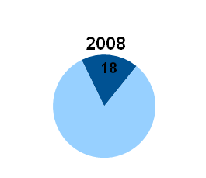
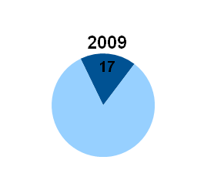
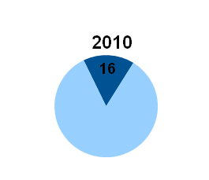
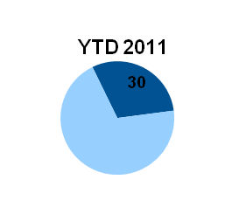
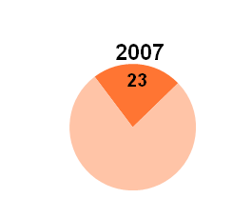
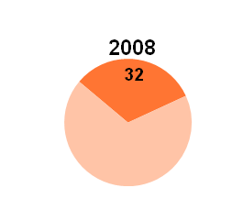
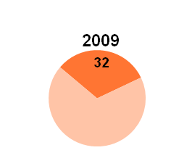
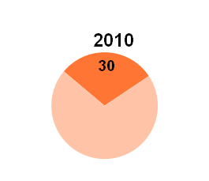
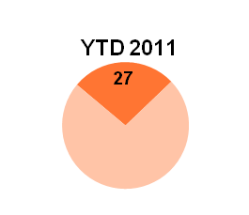
ETF share of U.S. exchange activity
ETF volume - shares
ETF volume - dollars
ETF share of share volume
ETF share of dollar volume
Source: Arcavision as of June 30, 2011
10

Slide 11
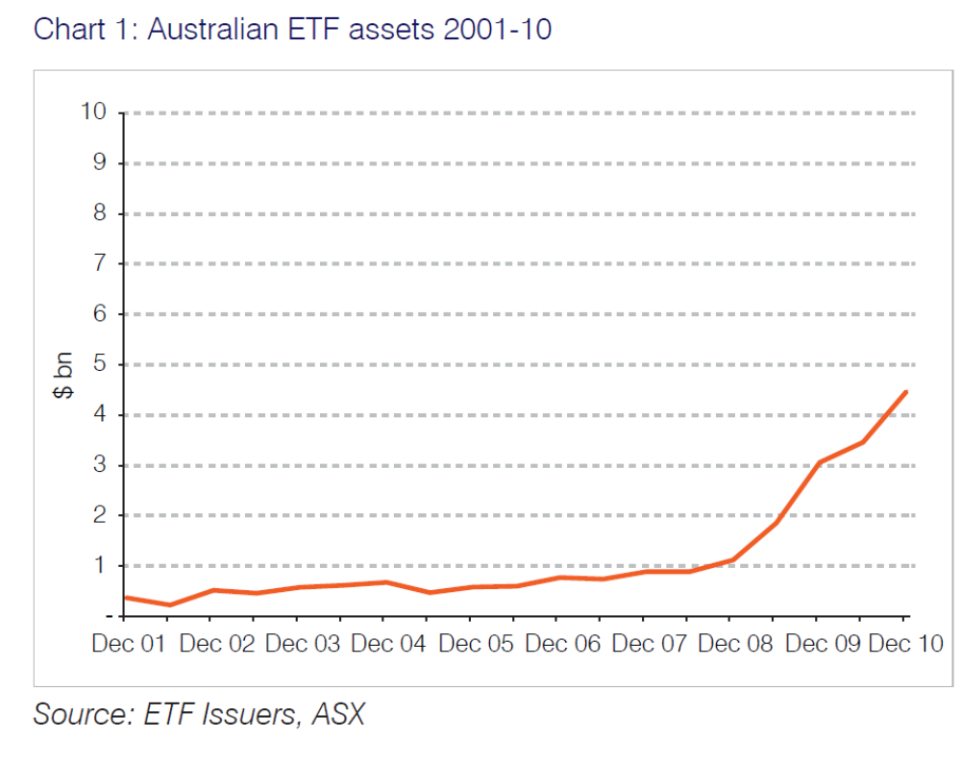
Australian ETF & ETP assets 2001 - 2010
Source: Tria Wealth Management 2011
11

Slide 12
In Australia, the ETF take-up is building
Key Australian ETF measures
Dec 09
Dec 10
Dec 11
% change
(Dec 10 – Dec 11)
Market cap ($mn)
3,079
4,478
4,176
-6.7%
Number listed
25
40
50
25.0%
12 month avg trades
14,189
14,200
16,436
15.7%
12 month avg value ($mn)
495
496.41
607.13
22.3%
Expect 2012 to be the year of fixed interest ETFs
Rule changes approved on January 9
Regulators remain cautious on synthetic ETFs
Source: ASX LMI Monthly Update as at December 2011
12
Notes:
12

Slide 13
Investors by segment – whole ETF market
Source: TRIA Partners April 2011
13

Slide 14
Types of ETFs
The most common ETF is just like any regulated managed investment scheme – it has a simple and transparent structure.
Physical ETFs
A synthetic ETF doesn’t necessarily hold the same assets as the index it tracks. It may hold assets which approximate the index, or even assets which are unrelated. The return of the ETF is derived from a derivative, typically a swap, which may deliver the entire return or partial return (‘swap enhanced’).
Synthetic ETFs
Exotic ETFs
ETFs offering different types of market exposures such as Commodities, Currencies, Leverage and Inverse.
14

Slide 15
Swap-based ETFs have counterparty risk
General counterparty risks:
Default scenarios:
Counterparty terminates the swap agreement early and provider has difficulty finding new counterparty
Price of the swap changes at the end of its term
The counterparty defaults on its collateral obligations, leaving assets underfunded
The counterparty defaults on its swap obligations and the fund has a mismatch between the underlying index and the collateral
Counterparty default causes collateral assets to be frozen
15

Slide 16
ETF’s laid bare: inside the transaction process
Primary Market
Secondary Market
Aggregated proceeds
(for ETF units)
Cash
(for ETF
units)
ETF units
(creation unit
size)
ASX
(Capital Markets)
Adviser
ETF units
ETF
Fund Manager
Authorised Participants
or Market Makers
Investor
Cash
Broker
Basket of
Securities
Source: Vanguard Investments
16

Slide 17
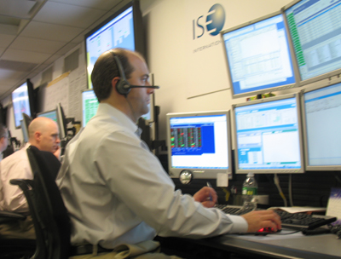
The role of the market maker
  A market maker stands ready to sell to buyers and buy from sellers.
  The market maker’s revenue is derived from the difference between buy and sell prices (spreads).
  In the ETF market, the ETF issuer (e.g. Vanguard) must appoint a liquidity provider (market maker) who has the ability to buy/sell Vanguard ETF units on the ASX.
17

Slide 18
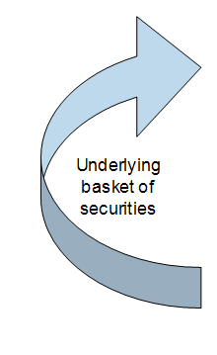

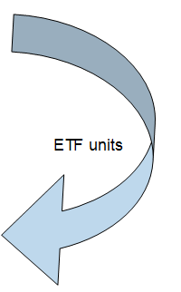
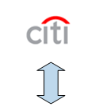
ETF basics: creations & redemptions
Citi delivers the basket to the fund in return for ETF units
i.e. iShares, SPDR
i.e. ASX, chi-x
18

Slide 19
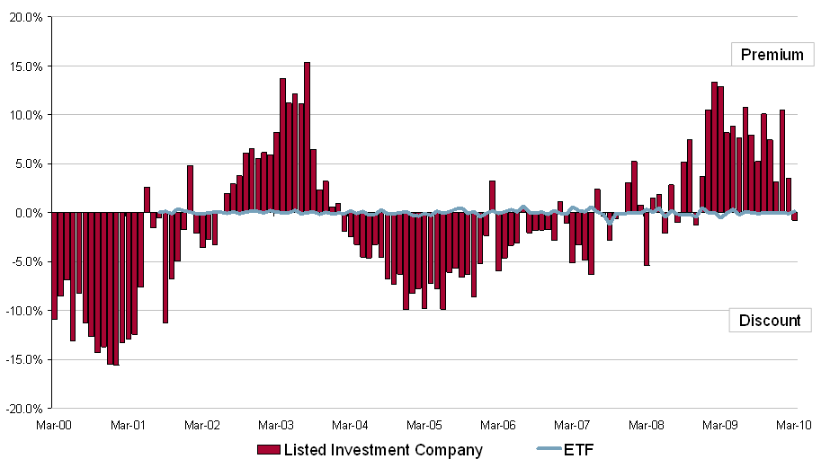
ETF premium/discount to NAV comparing ETFs to LICs
Australian Share Price Relative to NAV
Source: Bloomberg, dated as at March 2010
19

Slide 20
ETF liquidity – the broader picture
  There are 2 levels of liquidity to think about with ETFs:
    On screen; and
    Liquidity of underlying holdings
  The ability for the authorised participant to create new units or cancel units on a daily basis to meet the demand or supply on the market means that ETFs have an additional depth of liquidity.
  The ETF will generally trade around the Net Asset Value (‘NAV’) due to the ETF having an ‘open ended’ rather than ‘closed ended’ structure.
  If the market price moves away from the NAV, arbitrage by one or more of the trading participants will bring the price back to NAV
20

Slide 21
Impact of ETF spreads on all-on costs
Traditional managed fund
expense ratio:
Captures all fund expenses
  Investment Management
  Recordkeeping
  Services
  Buy/sell spreads may apply separately to cover new cash investing costs
Exchange-traded fund expense ratio:
Fund services
  Investment Management
  Services
=
Brokerage
Broker’s transaction fee
Spreads
Market maker trading costs
21

Slide 22
Setting spreads
The market maker may set spreads using the following:
Costs:
Revenue:
Buy shares in basket
ETF Spread to NAV*
Hedging costs
(e.g. futures spread)
Cost of capital
Processing costs
The ETF spread remains competitive due to the number of trading participants who can
offer to buy or sell the ETF.
ASX encourages certain spread levels with rebates on trading and settlement costs.
* Net Asset Value of Exchange Traded Fund
22

Slide 23
Back to basics
What are key drivers of portfolio performance?
The two most important portfolio decisions an investor makes are:
1) Asset Allocation
2) Costs
23

Slide 24
Determining your portfolio strategy
Strategic Asset Allocation drives performance
Brinson, Hood & Beebower, 1986 & 1991
Vanguard, 2003
“The enduring Importance of Asset Allocation”: 420 balanced/mutual funds were studied over a 40 year period to 2001
Key findings: On average, 77% of monthly variability is due to AA 100% of long-term performance is determined by AA The cost of implementing market timing and security selection was more than the returns achieved
Market timing: 2%
Objective: Superior long-term performance
Portfolio Design
Asset allocation: 94%
Security selection: 4%
Source: Brinson, Hood & Beebower (1986, 1991)
24

Slide 25
Manager selection vs. market power
2008 calendar returns
2009 calendar returns
Cash
International Fixed Interest (h)
Australian Fixed Interest
I-REITs
A-REITs
Emerging Market Equities
Developed Market Equities (h)
Australian Equities
Source: S&P, MSCI, UBS, Barclays Capital
25

Slide 26
Different ways investors use ETFs
In Core-Satellite investing
e.g. ETF as a patient core or satellite opportunity
In securing a diversified market exposure
e.g. directional view (long or short), rebalancing
As part of longer-term buy-and-hold investing
e.g. securing of market exposure for extended periods
As part of shorter-term market trading
e.g. implement thematic idea such as dividends, interim beta
As an alternative to other institutional instruments
e.g. futures, cash management
26

Slide 27
So what are the options?
Implementing your portfolio strategy
Direct Investments
(shares/property/TDs)
Managed Funds
ETFs
+
Shares
27

Slide 28
Case study
Core-Satellite strategy for international shares
What?
  A core-satellite strategy
  Combining ETFs with actively managed funds, LICs or directly held shares
Why?
  Provides investors with the opportunity for additional performance from their active positions but lowers the overall cost of the portfolio from a full active approach.
  Also suits investors who seek moderate risk to the benchmark
  Achieves diversification within your portfolio
28

Slide 29

ETF strategy – international shares
Vanguard® US Total Market Shares Index ETF (VTS)
Combined Vanguard All-World ex-US and US Total Market Shares Index ETFs
Vanguard® All World ex-US Shares Index ETF (VEU)
Designed to track the MSCI U.S. Broad Market Index
Low management fee of 0.07% p.a.
Index includes approximately 3,400 U.S. security holdings
Exposure to 93% of the
world sharemarkets
Low annual management
cost* of 0.15% p.a. using a
50:50 weightings split
Access to 5579 securities
in 47 countries
Designed to track the FTSE All-World ex-US index
Low management fee of 0.22% p.a.
Index includes approximately 2200 securities
Covers 46 developed and emerging market
Benefits of international shares ETFs:
Low cost,* simple way of accessing international equities
Provides greater portfolio diversification
Access to industries and companies not available in Australia
Long term high growth potential
* Does not include brokerage or bid ask spread incurred in transacting
Strategies are illustrative only and do not constitute advice
29
Notes:
29

Slide 30
Myths & misconceptions
All ETFs are derivatives
Fiction
All ETFs are the same in structure
Fiction
ETFs can collapse in event of a large redemption
Fiction
ETFs are only for market timers
Fiction
ETF liquidity should be measured by trading volume
Fiction
ETFs often trade close to NAV
Fact
ETFs are used by investors to gain instant market access
Fact
ETFs are low cost*, tax efficient** and transparent in structure
Fact
ETFs are illiquid
Fiction
*Investors may also incur brokerage and a bid ask spread when acquiring ETFs on the ASX
**Due to low turnover as a result of the indexing strategy
30

Slide 31
Case: for and against
ETFs – the benefits
ETFs – the pitfalls
ETFs capitalise on the strengths of indexing
  Diversification across entire markets
  Low costs*
  Potential tax efficiency**
  Transparency
  Low manager risk
ETFs offer the additional benefit of trading flexibility
Counterparty risks with synthetic structure
Variable spread costs
Trading costs
  Regular investments
Lack of understanding of pricing process
Risks with exotic structures
* Investors may also incur brokerage and a bid ask spread when acquiring ETFs on the ASX
** Due to low turnover as a result of the indexing strategy
31

Slide 32
Summary
Long term portfolio performance is driven predominately by
asset allocation
ETFs are an efficient way to secure market exposure as part of a long-term, disciplined investment approach
Investors need to understand risks – no silver bullet
Fixed interest ETFs are next product development category
  (ASX rules amended January 9 to allow them)
  Exotic/active ETFs?
ASX Aqua platform (which ETFs trade on) being expanded to offer unlisted fund transaction capability
32

Slide 33
Important information
This presentation contains general information and is intended to assist you. We have not taken anybody's circumstances into account so the information may not be applicable to your circumstances. Before making an investment decision, you should consider your clients circumstances and whether the information is applicable to their situation.
Past performance is not an indication of future performance. All ETF products are subject to market risk, which may result in the loss of principal. International ETFs involve additional risks, including currency fluctuations and the potential for adverse developments in specific countries or regions.
Vanguard Investments Australia Ltd (ABN 72 072 881 086 / AFS Licence 227263 / RSE Licence L0001335) (“Vanguard”) is the issuer of the Vanguard ETFs. Vanguard is the issuer of the Prospectus on behalf of the US listed ETFs described in the Prospectus. Vanguard has arranged for interests in the US ETFs to be made available to Australian investors via CHESS Depositary Interests that are quoted on the AQUA market of the Australian Securities Exchange (“ASX”).
Vanguard ETFs will only be issued to Authorised Participants, that is persons who have been authorised as trading participants under the ASX Operating Rules. Retail investors can transact in Vanguard ETFs through a stockbroker or financial adviser on the secondary market.
Investors should consider the Prospectus and Product Disclosure Statement (“PDS”) in deciding whether to acquire Vanguard ETFs. Retail investors can only use the Prospectus and PDS for informational purposes. You can access the PDS and Prospectus at vanguard.com.au
This information is intended for investors in Australia only. Information regarding the US-registered products does not constitute an offer or solicitation and may not be treated as an offer or solicitation in any jurisdiction where such an offer or solicitation is against the law or to anyone to whom it is unlawful to make such an offer or solicitation, or if the person making the offer or solicitation is not qualified to do so.
Standard & Poor’s® and S&P® are registered trademarks of Standard & Poor's Financial Services LLC ("S&P") and ASX® is a registered trademark of the Australian Securities Exchange Limited (“ASX”). These trademarks have been licensed for use by The Vanguard Group, Inc. Vanguard's ETF(s) are not sponsored, endorsed, sold or promoted by S&P, or ASX, and S&P and ASX make no representation, warranty or condition regarding the advisability of buying, selling or holding units/shares in the Vanguard ETF(s).
The funds or securities referred to herein are not sponsored, endorsed, or promoted by MSCI, and MSCI bears no liability with respect to any such funds or securities. For any such funds or securities, the PDS or Prospectus contains a more detailed description of the limited relationship MSCI has with Vanguard and any related funds.
”FTSE®” is a trade mark jointly owned by the London Stock Exchange Plc and The Financial Times Limited and is used by FTSE International Limited under licence. “All-World” is a trade mark of FTSE International Limited. “ASFATM” is a trade mark of The Association of Superannuation Funds of Australia (“ASFA”). The FTSE All-World ex-US Index are calculated by FTSE International Limited. FTSE and ASFA do not sponsor, endorse or promote this product and is not in any way connected to it and does not accept any liability in relation to its issue, operation and trading.
‘Vanguard’, ‘Vanguard Investments’ and the ship logo are the trademarks of The Vanguard Group, Inc.
© 2012 Vanguard Investments Australia. All rights reserved.
33

